Slide 1
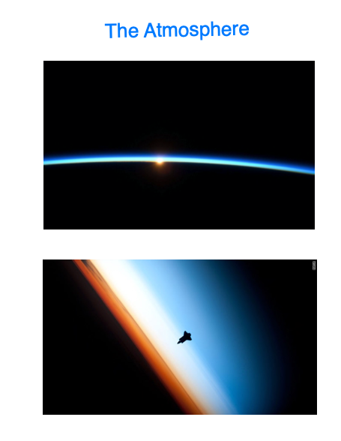

Slide 2
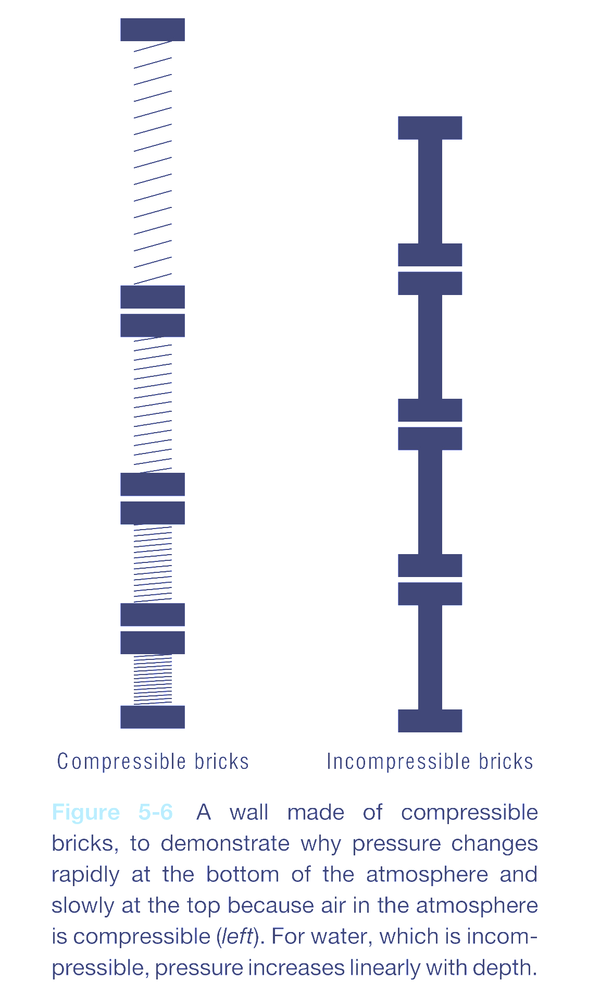
Atmospheric Pressure

Slide 3
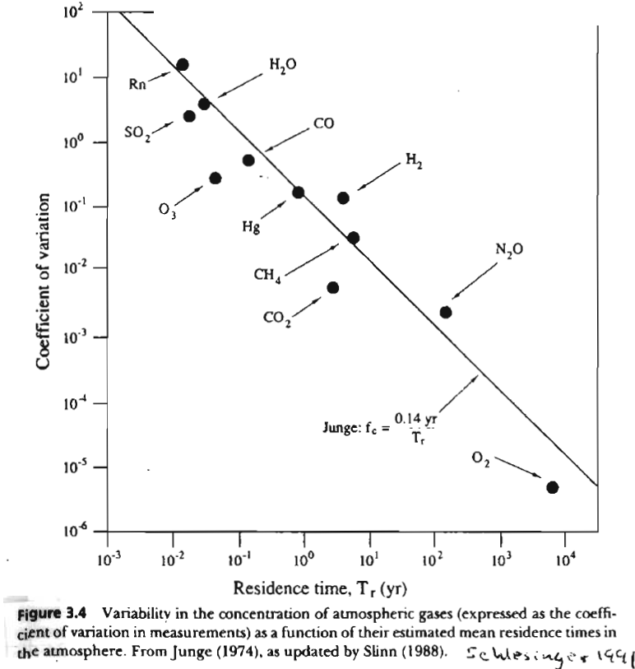

Slide 4
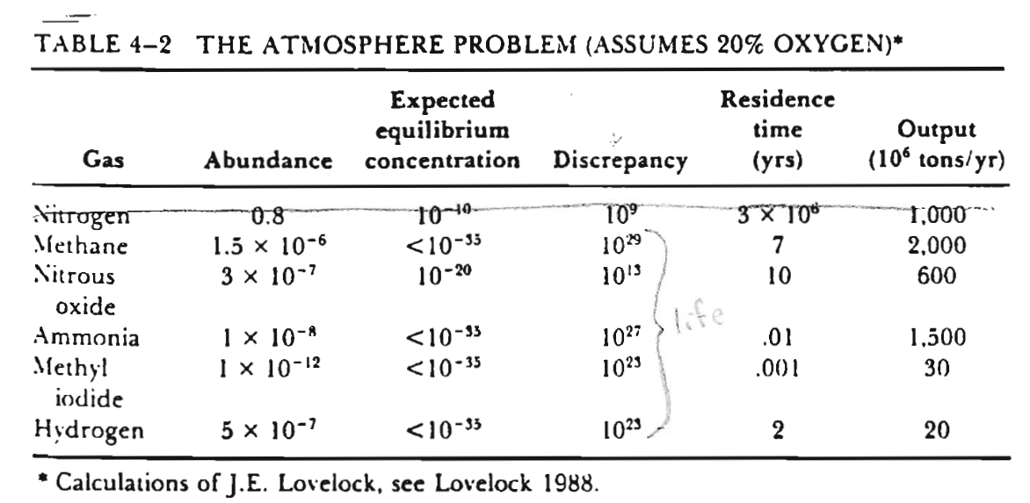

Slide 5
Vertical Structure of the Heterosphere

Slide 6
Sources of Atmospheric Aerosols
(mass emissions)
Deflation weathering ➔ 1 - 10 um 13 %
Sea Spray Salts ➔ 1 – 10 um 82 %
Sulfur Compounds ➔ 0.1 um 2 %
Other (soot, fire debris, organic cmpds) 3 %
~2.5 % of emissions are anthropogenic
~10 % of aerosol burden is anthropogenic
Mean Residence Time ~ 5 day.

Slide 7
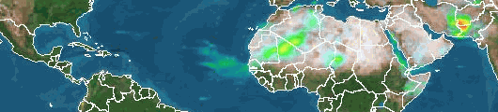
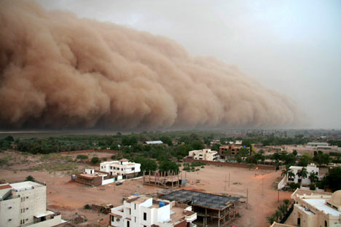
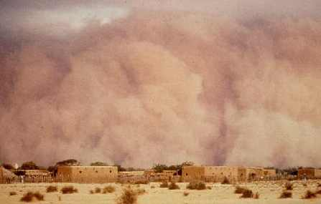
Aerosols transport materials
From land to sea
From continent to continent
From the sea to land
Notes:
http://www.dailymail.co.uk/pages/live/articles/news/news.html?in_article_id=452050&in_page_id=1770 The dust cloud over Khartoum sudan (picture on left)
http://www.islandnet.com/~see/weather/almanac/arc2002/alm02jun.htm

Slide 9
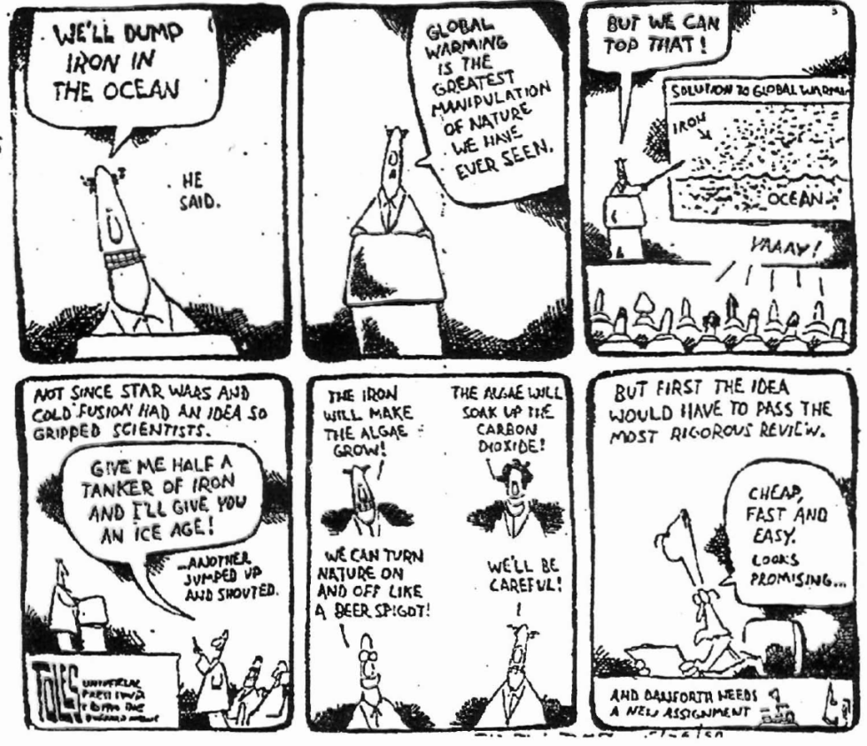

Slide 10
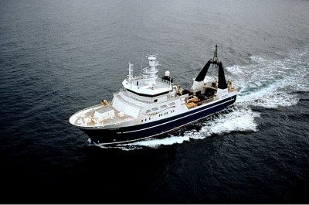
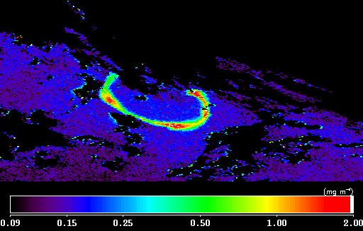
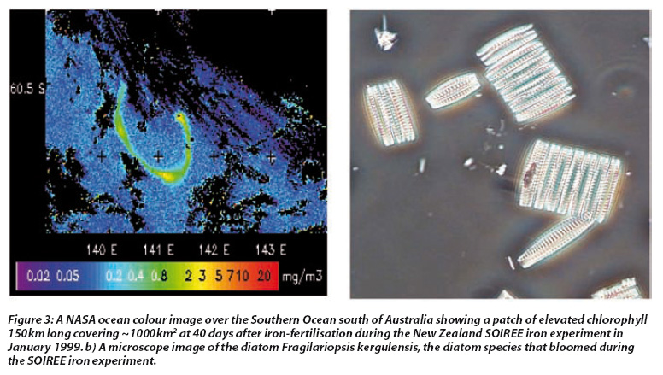
Notes:
http://disc.sci.gsfc.nasa.gov/education-and-outreach/additional/science-focus/ocean-color/soiree.shtmlhttp://earthobservatory.nasa.gov/Features/Martin/martin_5.php
A mesoscale phytoplankton bloom in the polar Southern Ocean stimulated by iron fertilization", Philip W. Boyd, Andrew J. Watson, Cliff S. Law, Edward R. Abraham, Thomas Trull, Rob Murdoch, Dorothee C.E. Bakker, Andrew R. Bowie, K.O. Buesseler, Hoe Chang, Matthew Charette, Peter Croot, Ken Downing, Russel Frew, Mark Gall, Mark Hadfield, Julie Hall, Greg Jameson, Julie LaRoche, Malcolm Liddicoat, Roger Ling, Maria T. Maldonado, R. Michael McKay, Scott Nodder, Stu Pickmere, Rick Pridmore, Steve Rintoul, Karl Safi, Philip Sutton, Robert Strzepek, Kim Tanneberger, Suzanne Turner, Anya Waite, and John Zeldis.
Nature, Vol. 407, 12 October 2000, pages 695-702.
"Importance of stirring in the development of an iron-fertilized phytoplankton bloom", Edward R. Abraham, Cliff S. Law, Philip W. Boyd, Samantha J. Lavender, Maria T. Maldonado, and Andrew R. Bowie.
Nature, Vol. 407, 12 October 2000, pages 727-730.
"Effect of iron supply on Southern Ocean CO₂ uptake and implications for glacial atmospheric CO₂", A.J. Watson, D.C.E. Bakker, A.J. Ridgwell, P.W. Boyd, and C.S. Law.
Nature, Vol. 407, 12 October 2000, pages 730-733.
"Glacial/interglacial variations in atmospheric carbon dioxide", Daniel M. Sigman and Edward A. Boyle.
Nature, Vol. 407, 19 October 2000, pages 859-869.
"Iron-stimulated changes in 13C fractionation and export by equatorial Pacific phytoplankton: Toward a paleo growth rate proxy", R.R. Bidigare, K.L. Hanson, K.O. Buesseler, S.G. Wakeham, K.H. Freeman, R.D. Pancost, F.J. Millero, P. Steinbeg, B.N. Pop, M. Latasa, M.R. Landry, and E.A. Laws.
Paleoceanography, 14, 1999, pages 589-595.

Slide 12
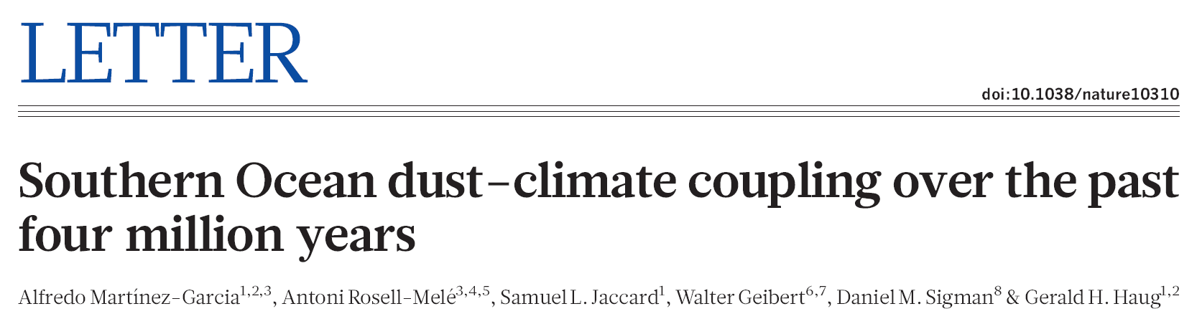
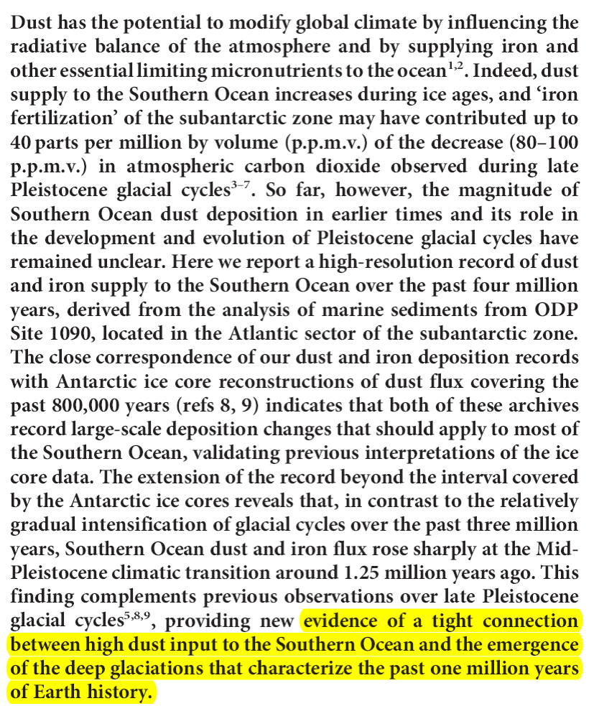
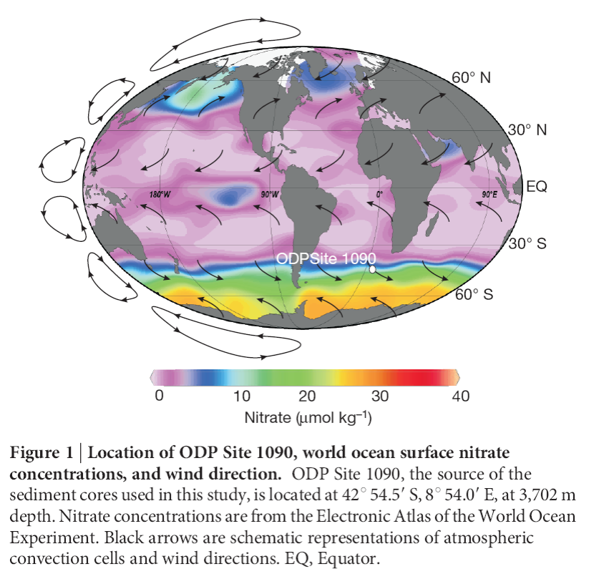

Slide 13
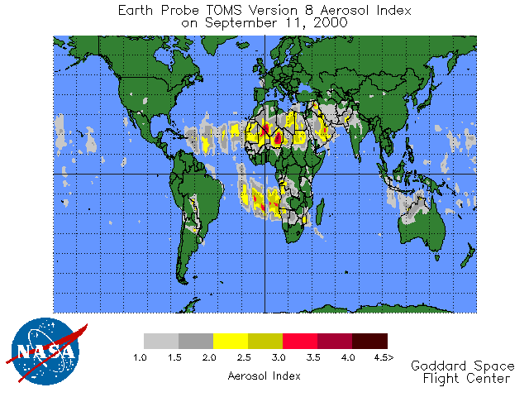

Slide 14
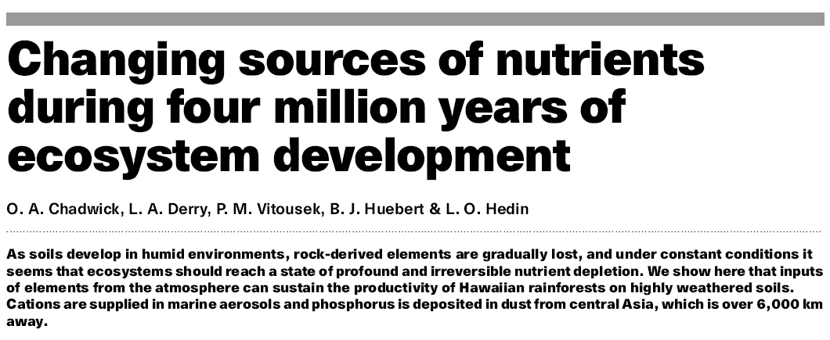
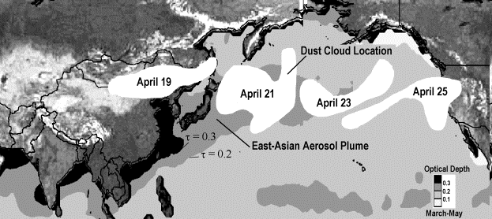
Husar et al. 2001
Notes:
http://capita.wustl.edu/Asia-FarEast/reports/jgr/AsianDustEpisodeApril1998Web001112.htm
JGR-ATM. 106 (D16): 18317-18330 AUG 27 2001
Power Point version
The Asian Dust Events of April 1998
R. B. Husar1, D. M. Tratt2, B. A. Schichtel1, S. R. Falke1, F. Li1 D. Jaffe3, S. Gassó3, T. Gill4, N. S. Laulainen5, F. Lu6, M.C. Reheis7, Y. Chun8, D. Westphal9, B. N. Holben10, C. Gueymard 11, I. McKendry12, N. Kuring10, G. C. Feldman10, C. McClain10, R. J. Frouin13, J. Merrill14, D. DuBois15, F. Vignola16, T. Murayama17, S. Nickovic18, W. E. Wilson19, K. Sassen20, N. Sugimoto21, W.C. Malm22
Abstract. On April 15 and 19 1998, two intense dust storms were generated over the Gobi Desert by springtime cold low pressure systems descending from the northwest. The dust was detected and its evolution followed by it’s yellow color on SeaWiFS satellite images, routine surface-based monitoring and through serendipitous observations. The April 15 dust cloud was recirculating and it was removed by a precipitating weather system over East Asia. The April 19 dust cloud crossed the Pasicic ocean within 5 days, subsided to the surface along the mountain ranges between British Columbia and California and impacted severely the optical and the concentration environment of the region. Over Asia, the dust clouds increased the albedo over the cloudless ocean and land by up to 10-20% but it reduced the near UV cloud reflectance, causing a yellow coloration of all surfaces. The yellow colored backscattering by the dust eludes plausible explanation using simple Mie theory with constant refractive index. Over the West Coast, the dust layer has increased the spectrally uniform optical depth to about 0.4, reduced the direct solar radiation by 30-40%, doubled the diffuse radiation and caused a whitish discoloration of the blue sky. On April 29, the average excess surface-level dust aerosol concentration over the valleys of the West Coast was about 20-50 µg/m3 with local peaks >100 µg/m3. The duat mass mean diameter was 2-3 µm and the dust chemical fingerprints were evident throughout the West Coast and extended to Minnesota. The April 1998 dust event has impacted the surface aerosol concentration 2-3 times more then any other dust event since 1988. The dust events were observed and interpreted by an ad-hoc international web-based virtual community. It would be useful to set up a community-supported web-based infrastructure to monitor the global aerosol pattern for such extreme aerosol events, alert and inform the interested communities and to facilitate collaborative analysis for improved air quality and disaster management.
Figure 4. Approximate location of the April 19 dust cloud over the Pacific Ocean between April 21-25. The approximate dust pattern was derived from the daily SeaWiFS images, GOES 9 and GOES 10 images and TOMS absorbing aerosol index data. Over the Pacific Ocean, the dust cloud followed the path of the springtime East-Asian aerosol plume shown by the contours of optical thickness derived from AVHRR data.

Slide 15
Dust from Africa can even affect
air quality in Texas
2013

Slide 16
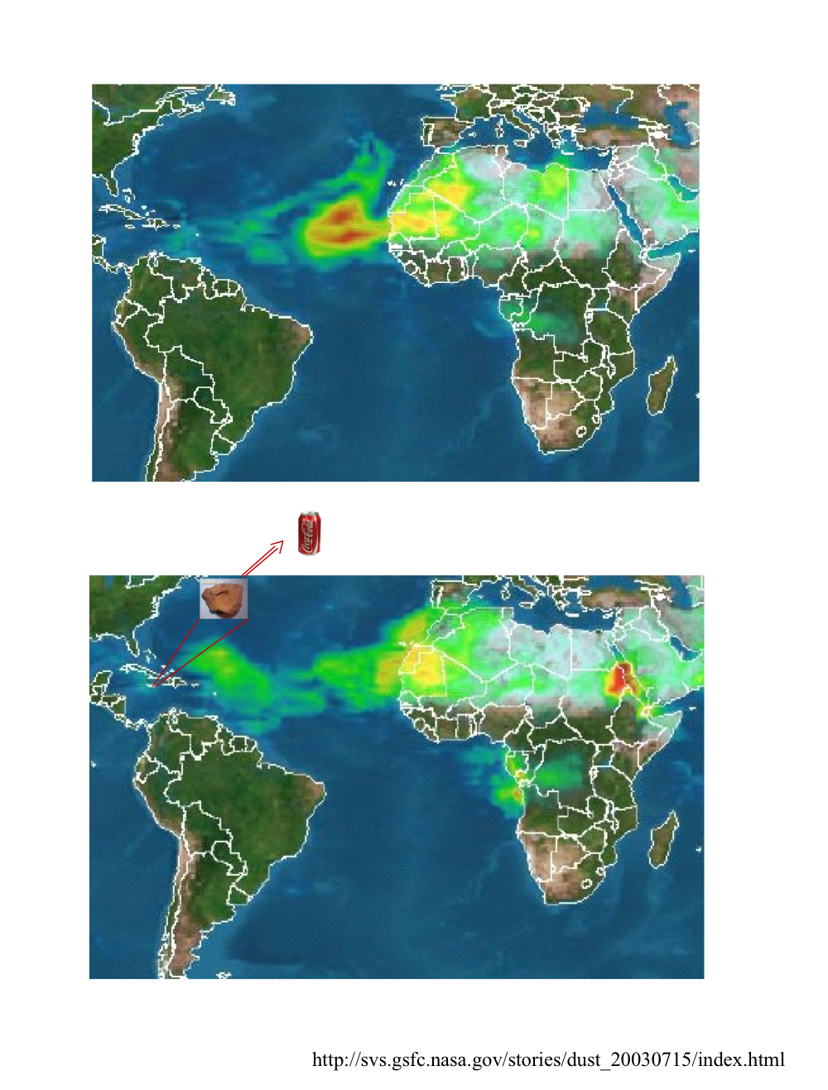
Notes:
Image 2 TOMS dust and smoke (equatorial Africa) image from 17 June 1999.
The study's authors, Natalie Mahowald, a researcher at the National Center for Atmospheric Research, Boulder, Colo., and University of California, Santa Barbara (UCSB), and Lisa Kiehl, a graduate student at UCSB, believe the interaction between clouds and aerosols is critical for understanding climate change. Clouds play a pivotal role in reflecting and absorbing the Sun's rays. Clouds also absorb and reflect radiation emitted from Earth's surface. The dust and cloud interplay also helps explain rainfall patterns over the Sahara Desert and south of that area.
Image 3 TOMS dust and smoke (equatorial Africa) image from 2 July 1999.
In low clouds such as cumulus and stratocumulus clouds, near the Sahara desert, water attaches to the dust particles. Higher dust concentrations can suppress rainfall and enhance drought conditions, by dispersing water among the dust particles, so that water droplets are not heavy enough to fall. This creates more thin low clouds, and less rain.
In high clouds, such as cirrus, cirrostratus, and deep convective clouds, there is some evidence that dust particles over wetter regions south of the desert provide surfaces for ice crystals to form around. These ice crystals grow rapidly, drawing moisture from surrounding cloud droplets, become heavier and fall, generating more rain and reducing the total amount of high clouds.
Dust from North Africa, where the desert lies, has blown increasingly into the atmosphere since the 1960s. Though the reasons for this are not clearly understood, some scientists believe the increase may be linked to human activity.
The study, which appeared in a recent issue of Geophysical Research Letters, used 16 years of monthly mean observations from satellites, ground stations, and computer models to look at the relationship between dust particles in the air, called mineral aerosols, and cloud properties.
Data on how many and how thick clouds were, and cloud top pressure and temperature, came from NASA's International Satellite Cloud Climatology Project (ISCCP). ISCCP data covered 1984 to 1999 and combined Advanced Very High Resolution Radiometer (AVHRR) data from 3 satellites created and launched by NASA, including GOES-8, GOES-10, and GOES-12.
The study also used data from the Total Ozone Mapping Spectrometer (TOMS) instrument to determine the amount of radiation being absorbed by aerosols between 1984 and 1990. Data from the ground in Barbados was collected by the University of Miami.
This is the first long-term regional study to confirm observations that mineral aerosols in both low and high clouds can act as kernels for precipitation to form around. It is also the first study to suggest that African dust interacts with clouds over a large region.
The study found a positive correlation between low altitude cloud amounts and dust at the coast of North Africa, which supports the theory that dust particles act as a place for water droplets to form around in thin low clouds.
The researchers also found a negative association between high clouds and dust along the equator across North Africa and the Atlantic Ocean. That is, more dust creates heavy ice particles in high clouds that rain down and ultimately reduce high cloud amounts. Still, since there are no long term ground measurements for dust and high clouds in these areas, and because it has been hard to measure these high clouds with satellites, it is difficult to make firm conclusions regarding ice forming around dust kernels, high clouds and rainfall.
NASA's Earth Science Enterprise is committed to studying the primary causes of the Earth system variability, including both natural and human-induced causes.
NASA funded the study in cooperation with National Science Foundation. The study exemplifies the unique advantages of space-based platforms for monitoring global transport, interactions, and feedbacks of aerosols.

Slide 17
From the sea to land

Slide 19


Dust
Smoke
Notes:
http://toms.gsfc.nasa.gov/aerosols/aerosols_v8.html

Slide 20
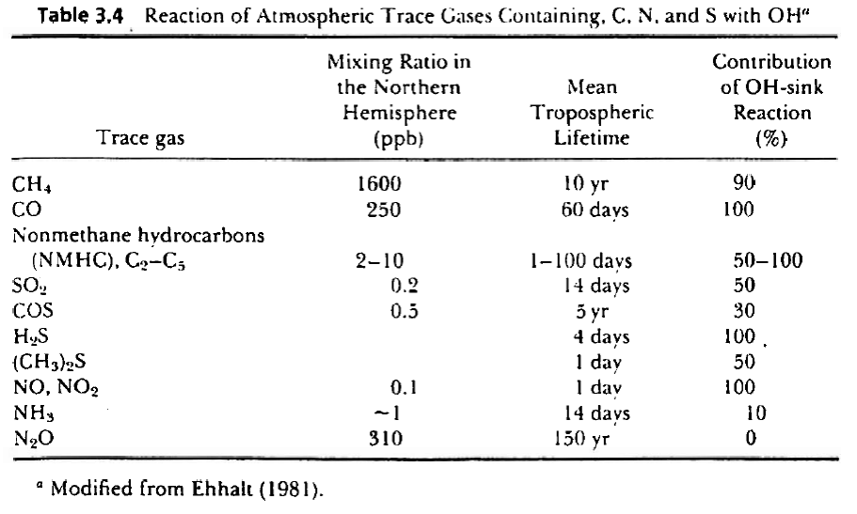
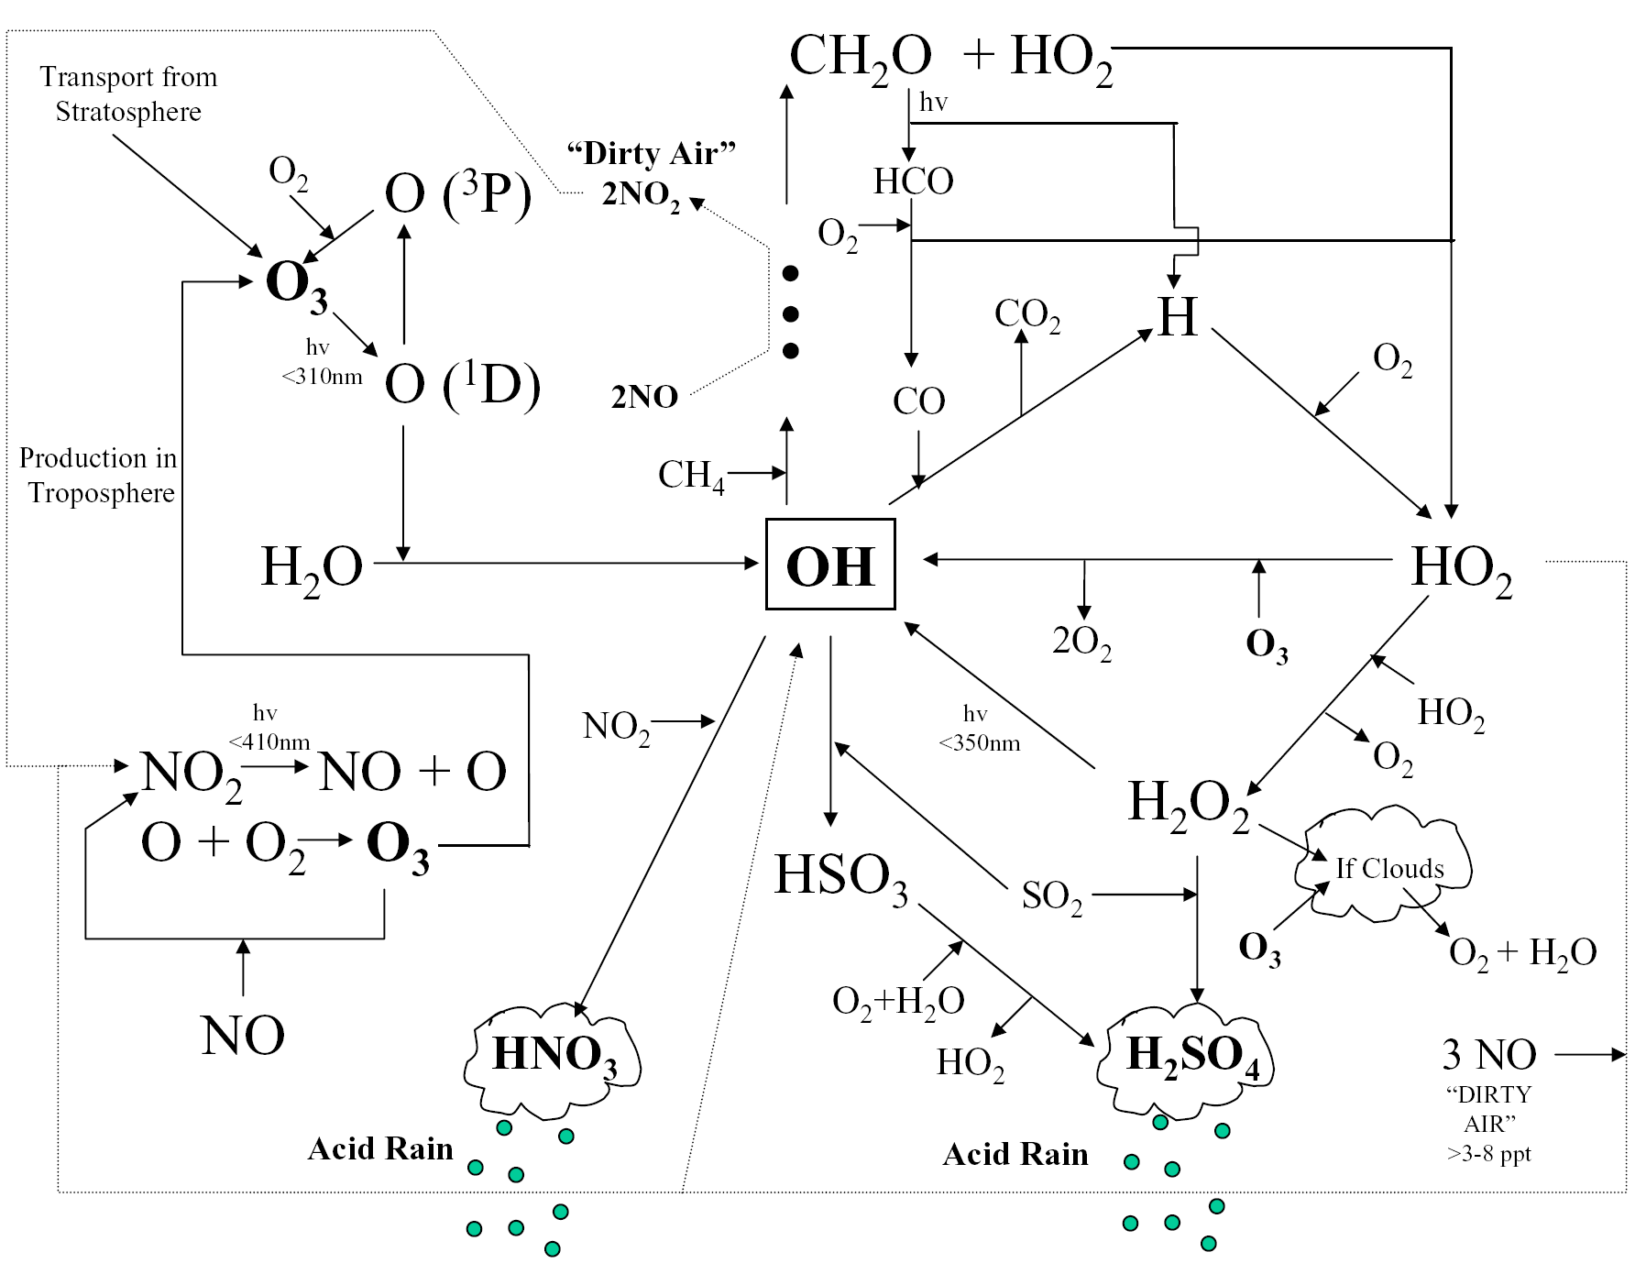
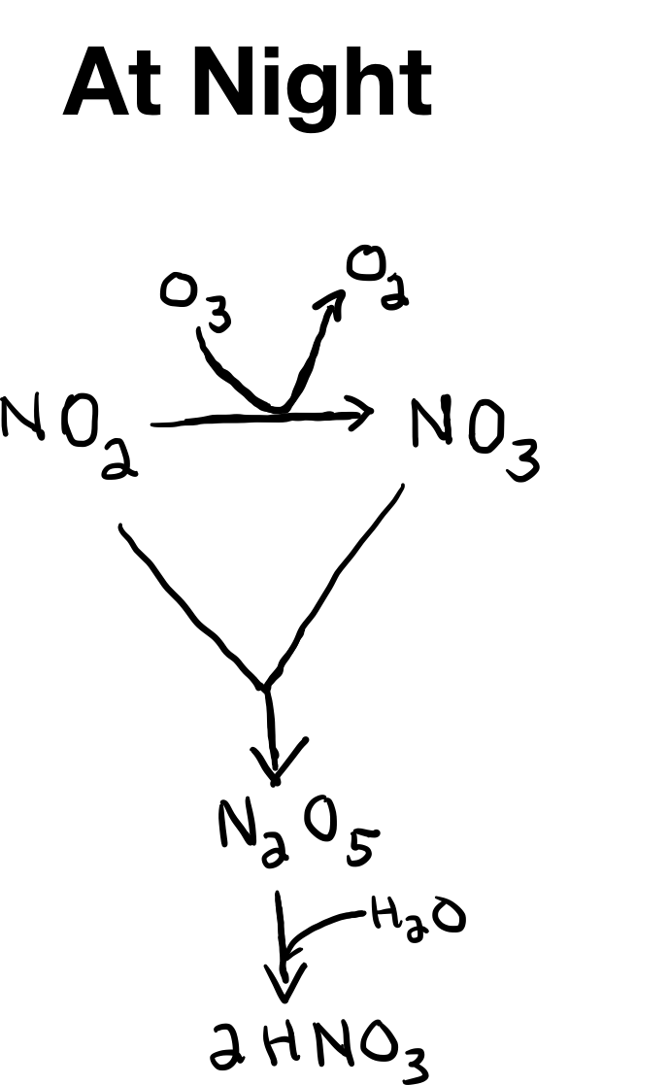
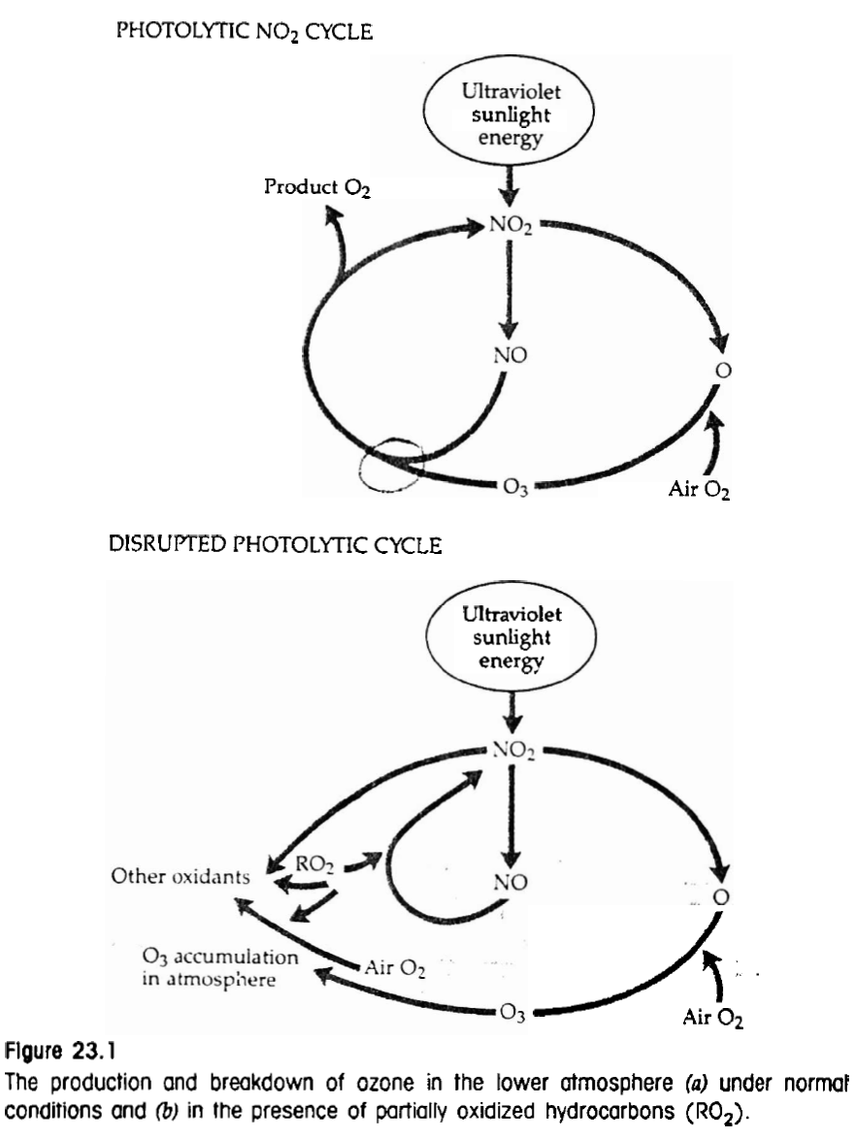

Slide 21
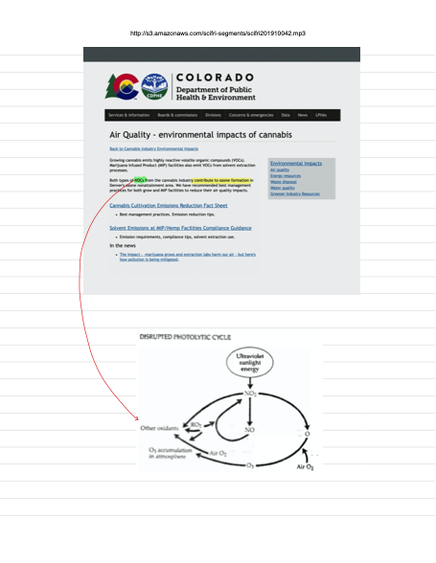

Slide 22
Atmospheric Composition Affects Atmospheric Chemistry
Increasing tropospheric ozone
Due to NO_{x} (NO & NO₂) emissions
And hydrocarbon emissions
Increasing acid deposition
Due to H₂SO₄ & HNO₃
Formed from SO_{x} & NO_{x} emissions
Notes:
http://dwb.unl.edu/teacher/nsf/c09/c09links/www.casahome.org/sulphur.htm
SOx refers to all sulphur oxides, the two major ones being sulphur dioxide (SO2) and sulphur trioxide (SO3). Sulphur dioxide is a colourless gas with a pungent, irritating odour and taste. It is highly soluble in water forming weakly acidic sulphurous acid. When sulphur dioxide combines with the oxygen (O2) in the air some sulphur trioxide is slowly formed. Sulphur trioxide rapidly combines with water to produce sulphuric acid. The lifespan of sulphur oxides in the atmosphere is from 4 to 10 days.
Sulphur dioxide is used in many industrial processes such as chemical preparation, refining, pulp-making and solvent extraction. Sulphur dioxide is also used in the preparation and preservation of food because it prevents bacterial growth and the browning of fruit.
Sources
Natural sources of sulphur dioxide include volcanoes and hot springs. Sulphur dioxide is also formed by the oxidation of hydrogen sulphide (H2S), a toxic gas that smells like rotten eggs. Oxidation occurs when hydrogen sulphide combines with the oxygen in air. Hydrogen sulphide is released by marshes and other places on land and in oceans where biological decay is taking place. Hydrogen sulphide is frequently found with natural gas. These deposits are referred to as sour gas.
Man-made sources of sulphur dioxide include sour gas processing, oil sands production, coal combustion, ore refining, chemical manufacturing and other fossil fuel processing and burning.
Canada's sulphur dioxide emissions are about 15 percent of those of the United States, and Alberta's emissions are about 15 percent of Canada's.
Of the 626 kilotonnes of sulphur dioxide emitted in Alberta in 1988, sour gas plants accounted for 38 percent, oil sands 29 percent and coal-fired power plants 16 percent. Sulphur trioxide is generally emitted with sulphur dioxide at about one to five percent of the sulphur dioxide emission rate.
Wikipediia
NO_{x} (often written NOx) refers to NO and NO₂. They are produced during combustion, especially at high temperature. These two chemicals are important trace species in Earth's atmosphere. In the troposphere, during daylight, NO reacts with partly oxidized organic species (or the peroxy radical) to form NO₂, which is then photolyzed by sunlight to reform NO:

Slide 23
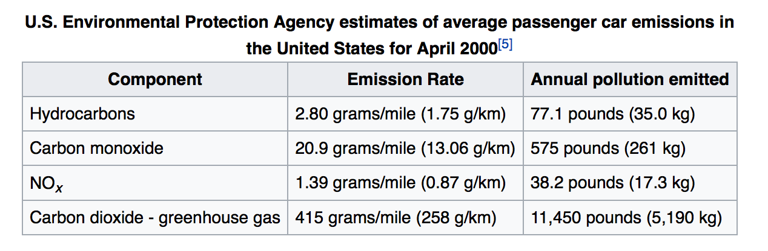
Oxidized N & S gases result from combustion
NO_{x}- From fossil fuels, biomass, & high temp. combustion
SO_{x} - From burning of fossil fuels

Slide 24
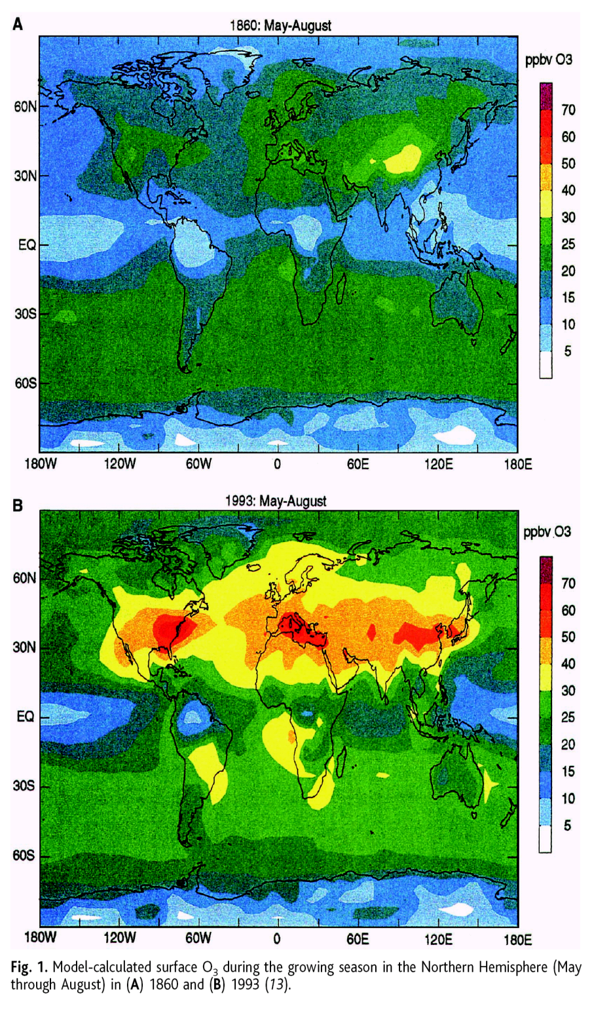
Tropospheric Ozone has increased
in time & space
Akimoto 2003
Notes:
Science 2003 Akimoto 2003

Slide 25
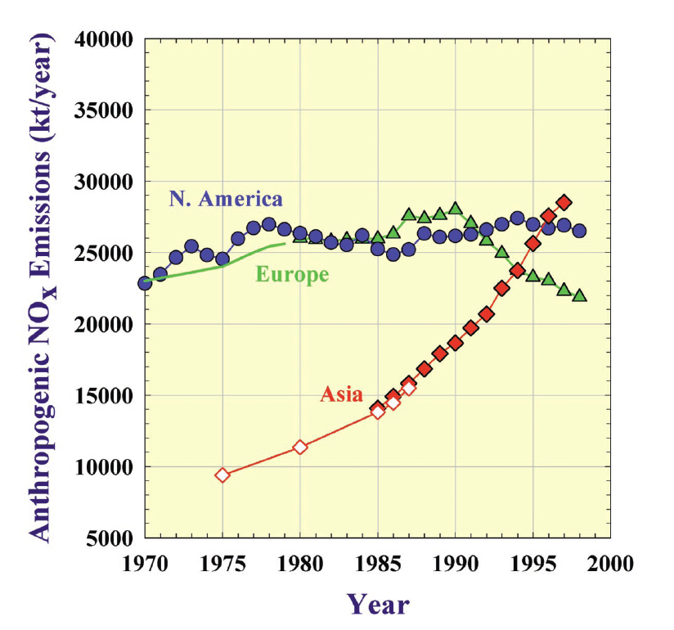
Tropospheric ozone is likely
to continue to increase
Akimoto 2003
Notes:
Science 2003 Akimoto 2003

Slide 26
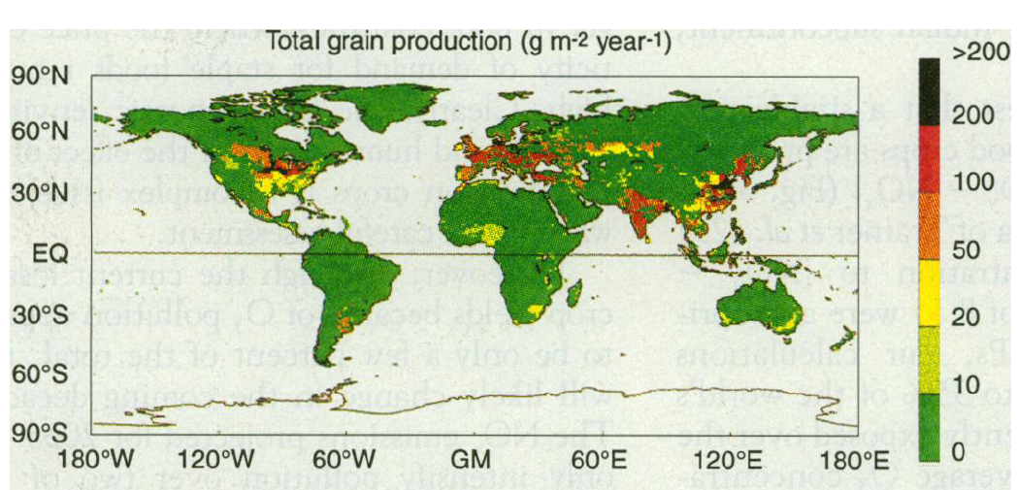
~ 10-35% of the world's grain production
may occur regions where ozone pollution may reduce crop yields
Chamedies et al. 1994

Slide 27
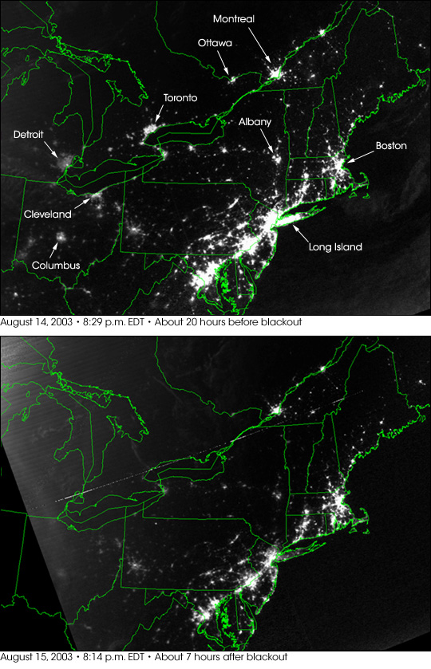
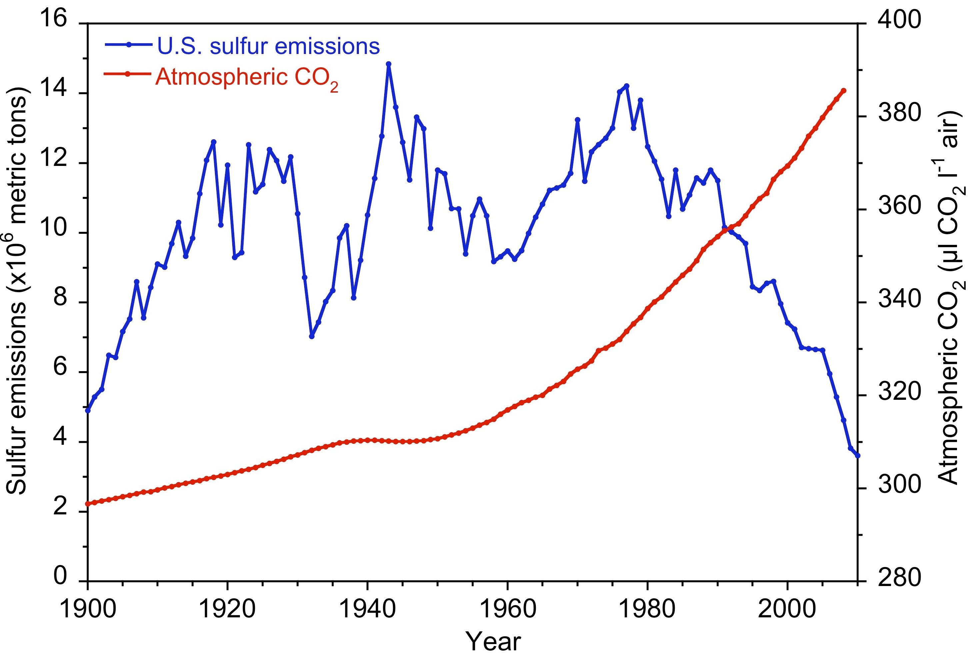
Atmospheric Chemistry Can Respond to Changes in Pollutant Emissions
24 hours into the blackout
SO₂ down 90%
O₃ down 50%
Visual range up > 40 km
Over much of the eastern US
Clean Air Act
Clean Air Act
Amendments
Figure 1. Historic sulfur emissions in the U.S. (LeFohn et al. 1999) and atmospheric [CO₂]. There has been a 60% reduction in S deposition in the Central Appalachian Mountains since 1978. From Thomas et al. 2013.
Notes:
The August 2003 electrical blackout that affected over
100 power plants in the northeastern U.S. and southeastern
Canada provided a unique opportunity to evaluate the
contribution of power plant emissions to regional haze
and ozone (O3).

Slide 28
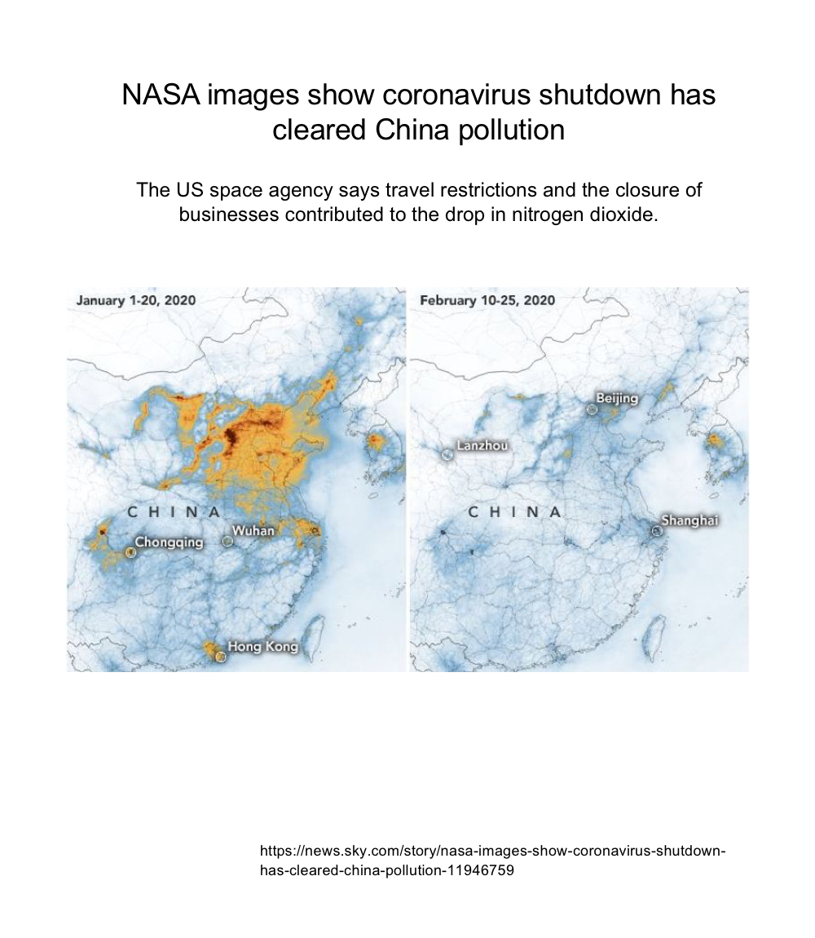

Slide 29
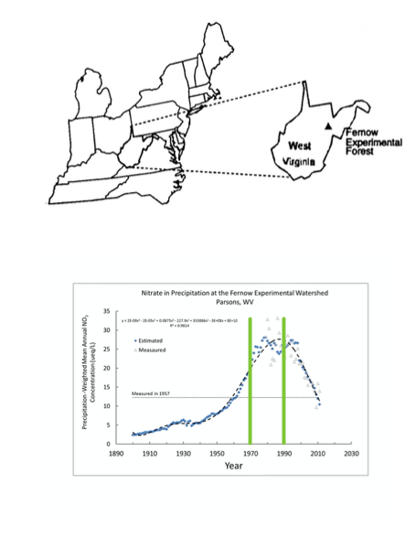

Slide 30
Types of Atmospheric Circulation

Slide 31
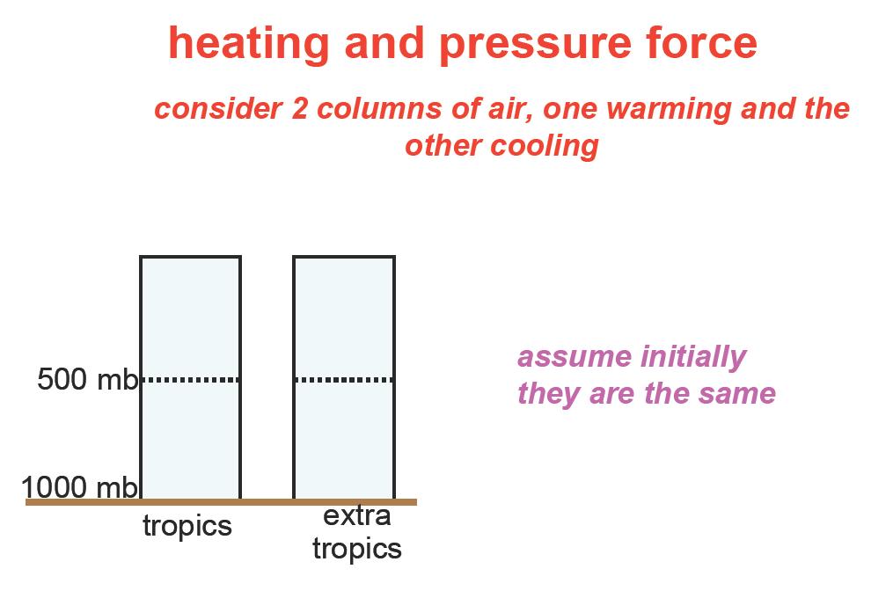
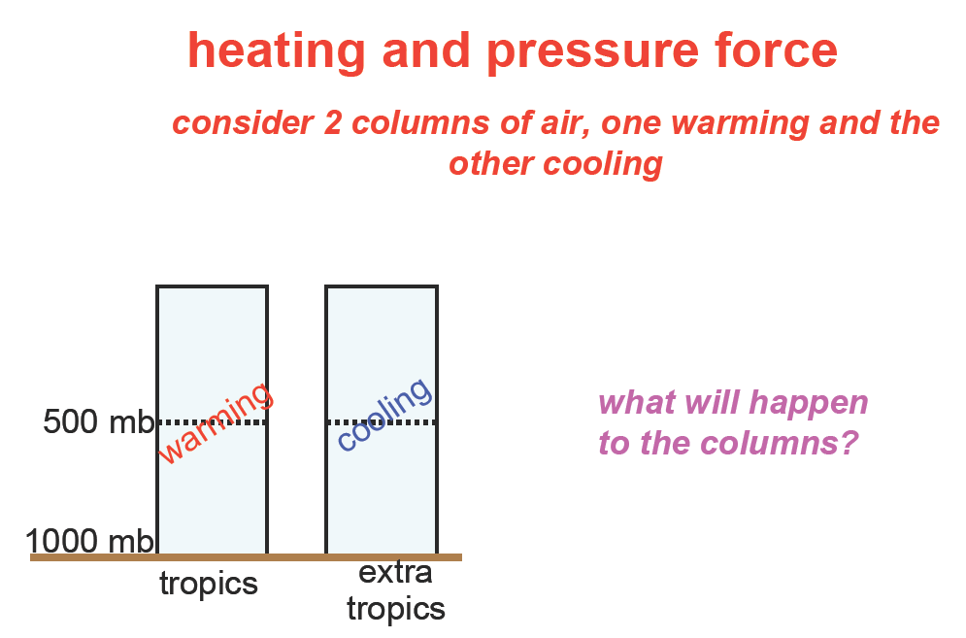
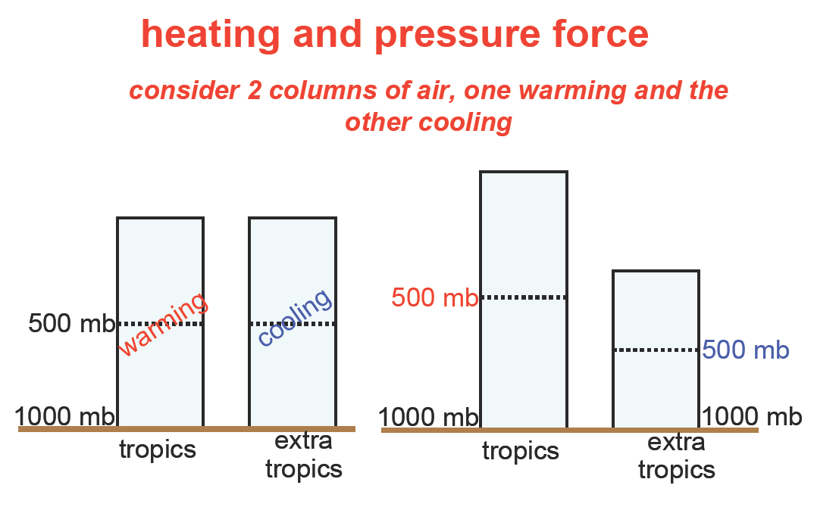
Consider two columns of air, one warming
and the other cooling
http://instaar.colorado.edu/~lehmans//env-issues/lectures.html

Slide 32
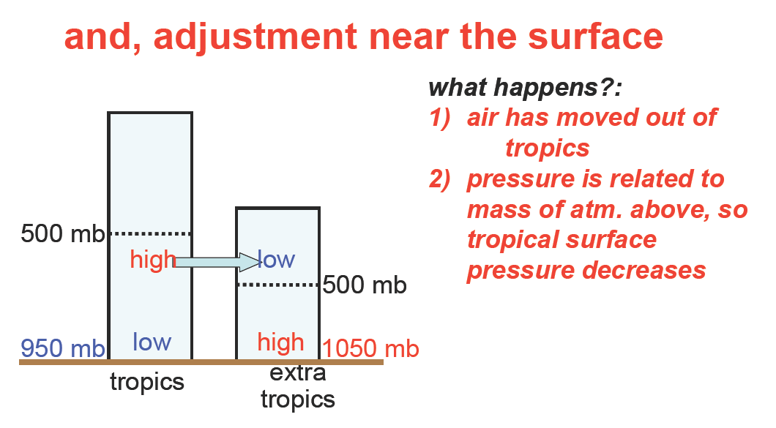
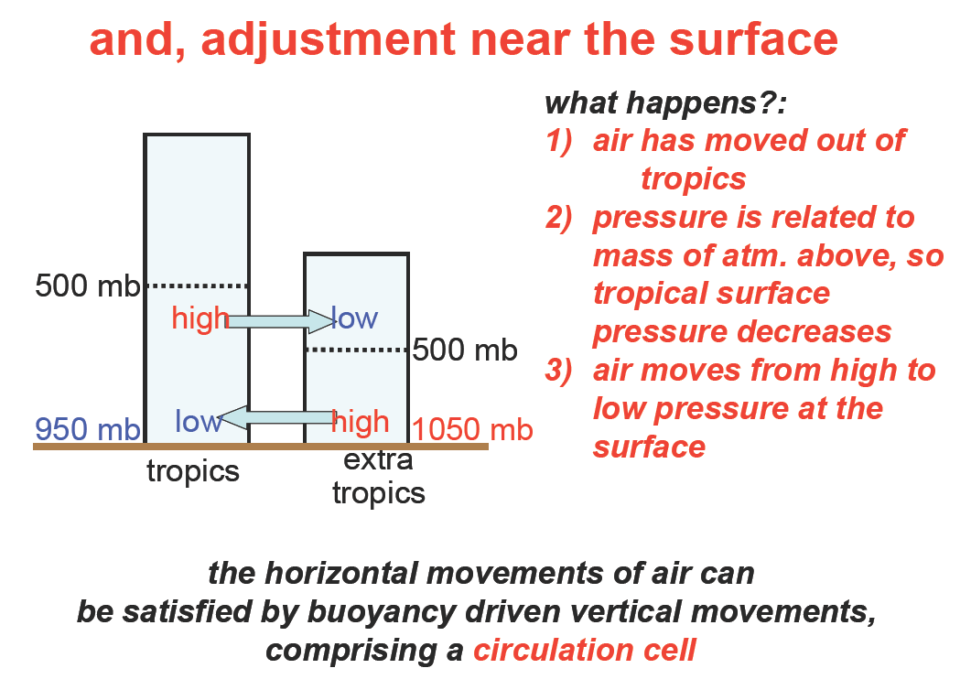
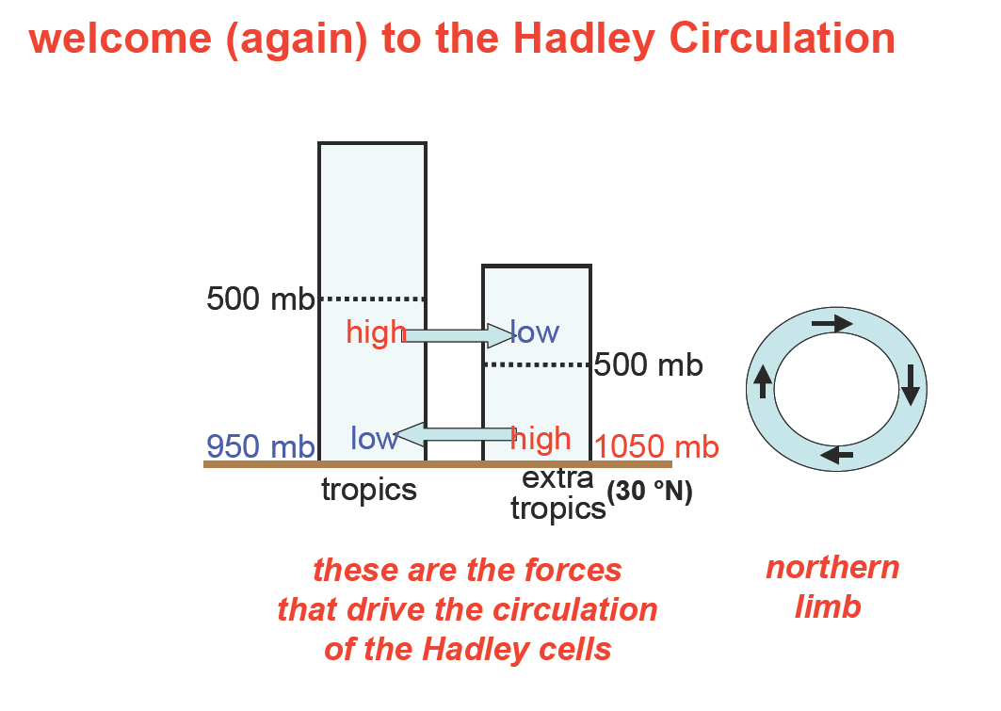
What happens next?
Hadley Cell
http://instaar.colorado.edu/~lehmans//env-issues/lectures.html

Slide 33
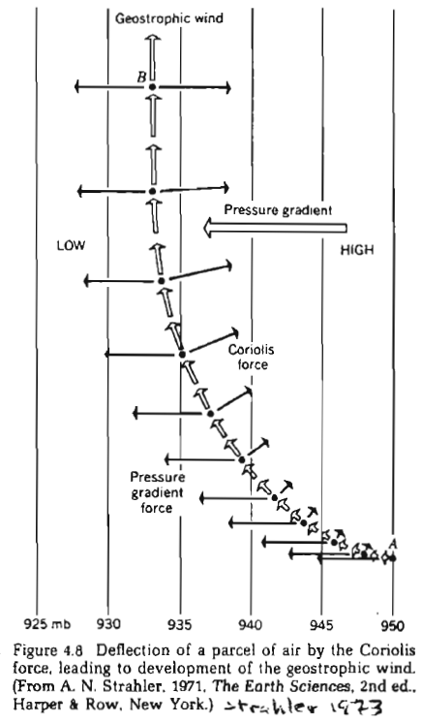
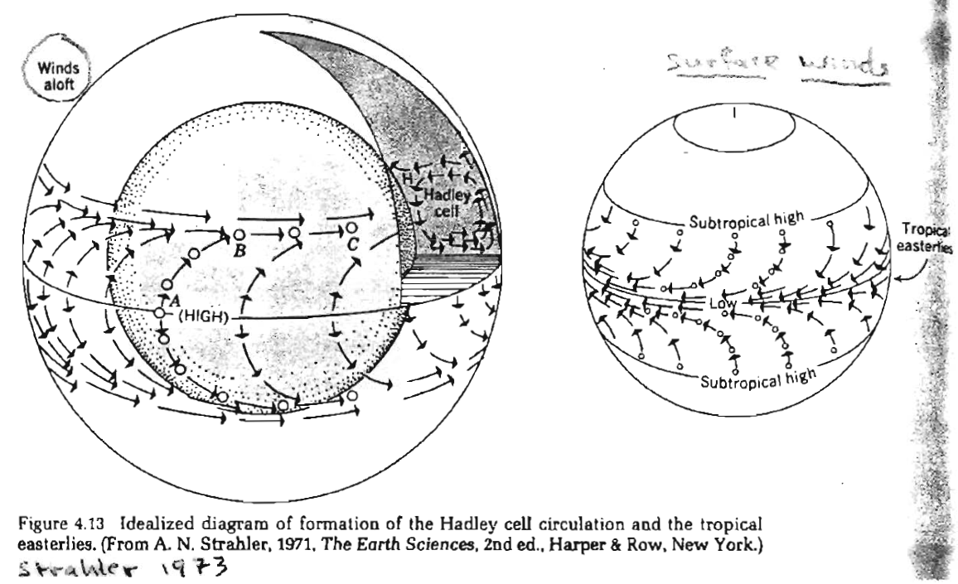

Slide 34
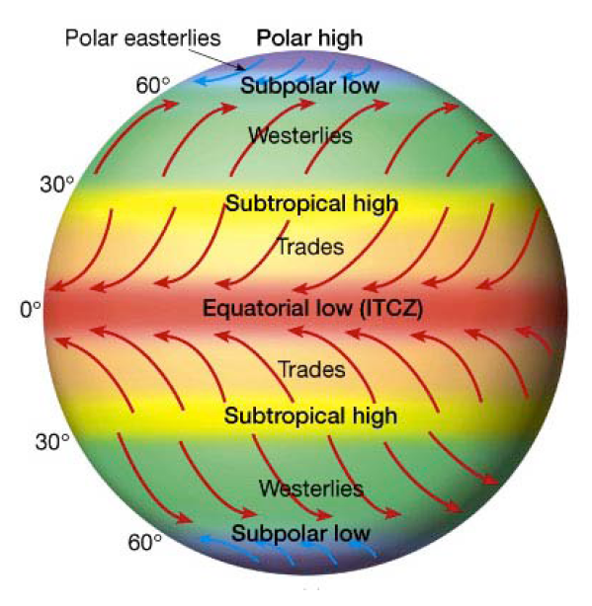
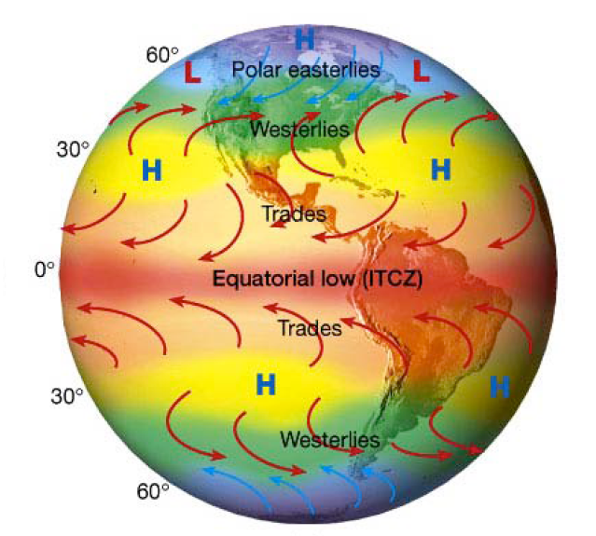
Pattern of General Circulation of Surface Winds
Surface pressure “belts” become cells in response to differential heating of land and sea and physical barriers to flow.
http://instaar.colorado.edu/~lehmans//env-issues/lectures.html
Notes:
instaar.colorado.edu/~lehmans//env-issues/.../S09_3520_7comp.pdf
http://instaar.colorado.edu/people/bios/lehman.html

Slide 35
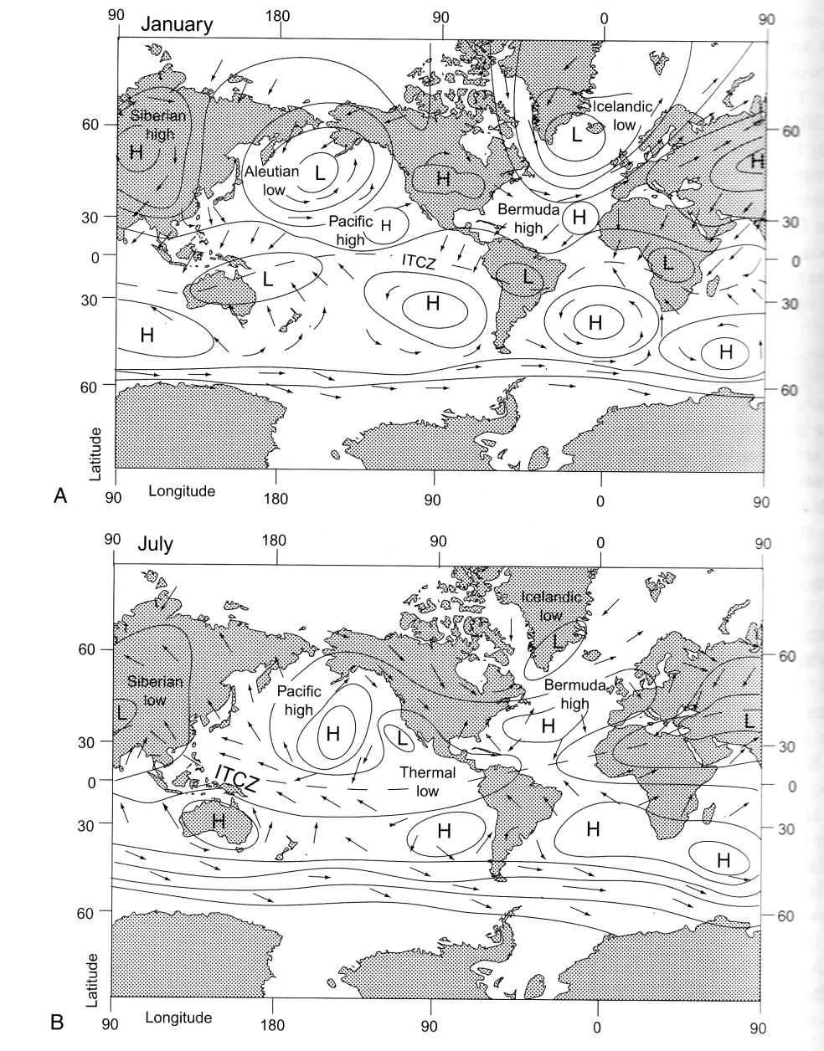
Cyclonic Circulation
From Chapin et al. 2002

Slide 36
